Slide 1
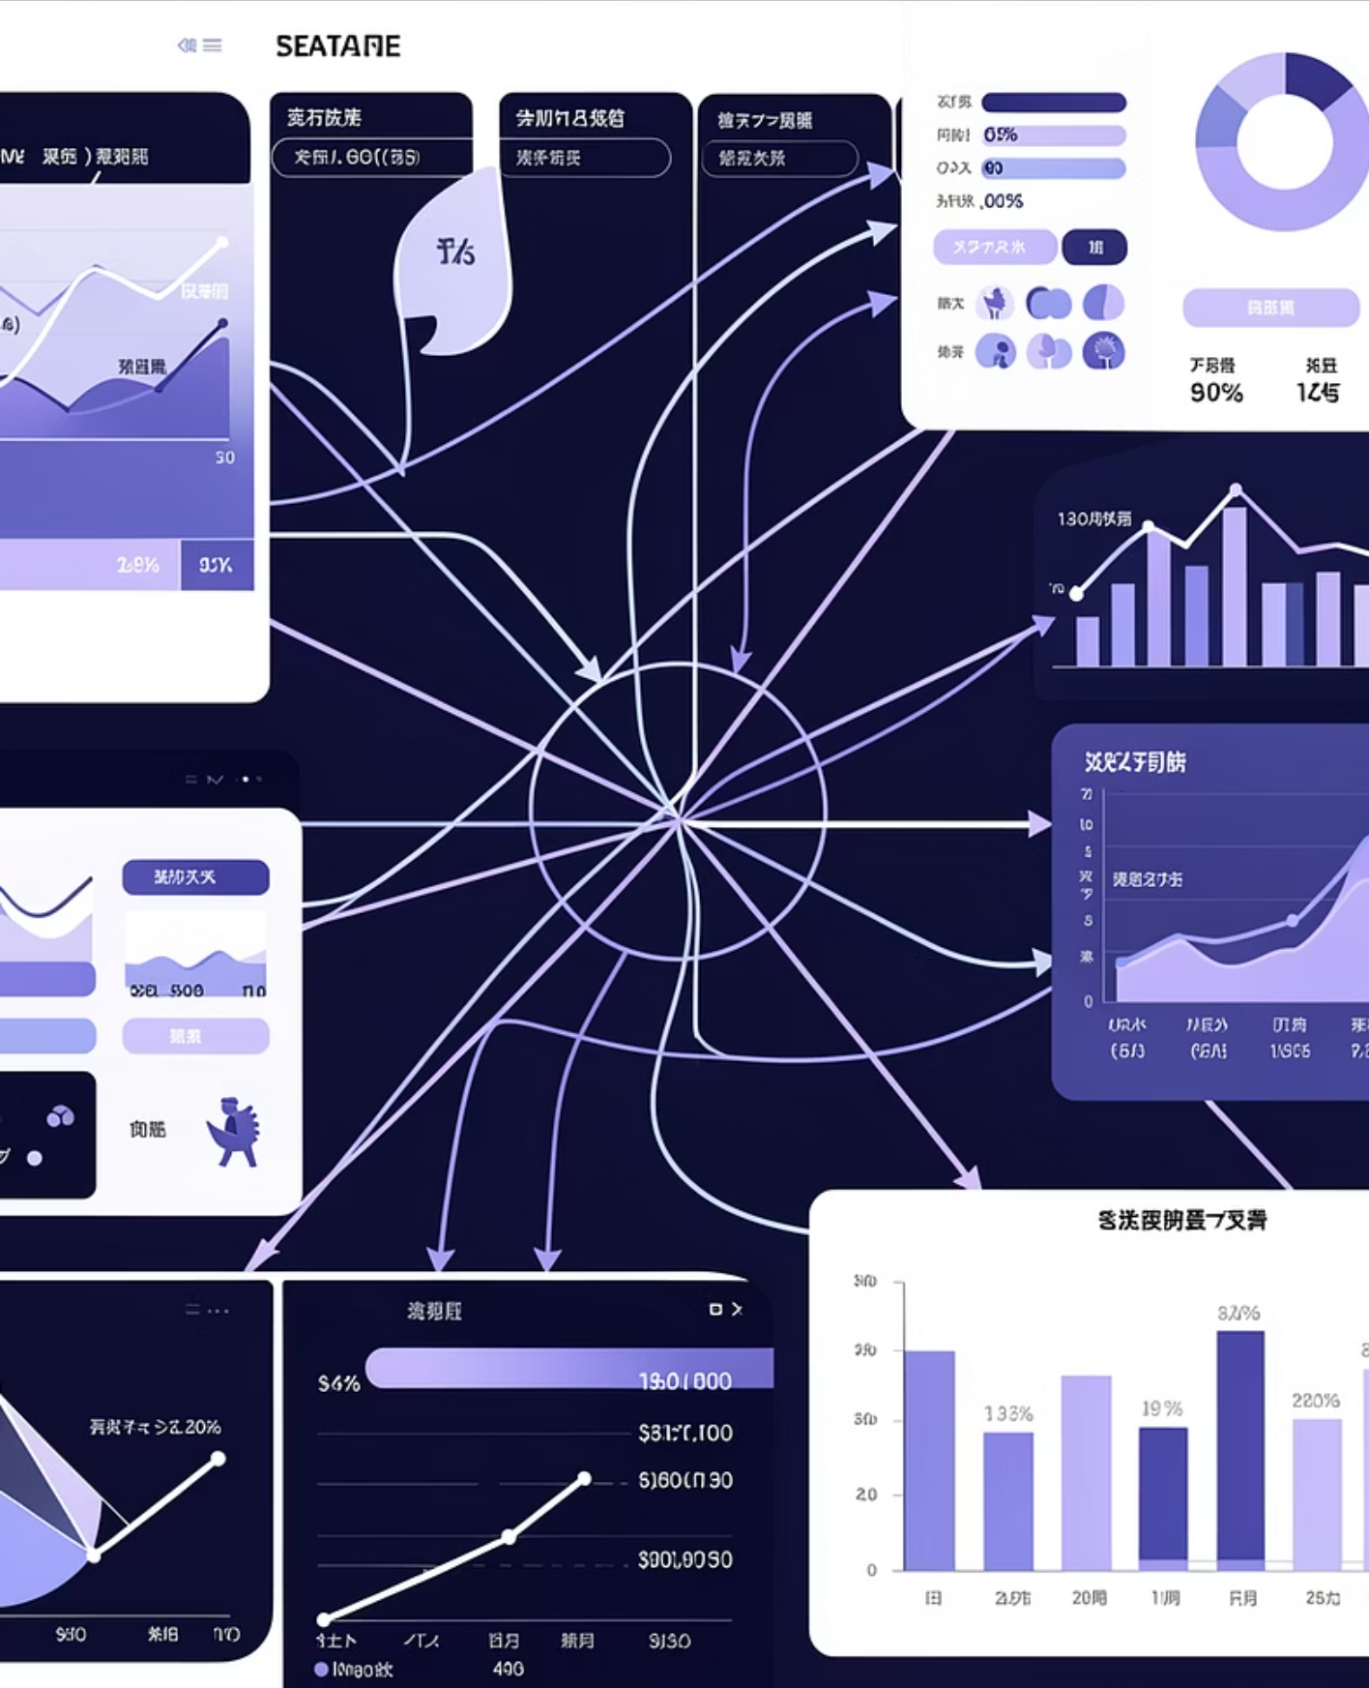
Customer Shopping Behavior Analysis
-DIBYA SEN JAL

Slide 2
Project Overview
Analyze Behavior
Uncover Insights
Guide Decisions
3,900 purchases across categories.
Spending patterns, segments, preferences.
Optimize business strategy.

Slide 3

Dataset Summary
3,900
18
Rows
Columns
Key Features:
Customer demographics
Purchase details
Shopping behavior
Missing Data: 37 values in Review Rating.

Slide 4

Exploratory Data Analysis (Python)
Initial Exploration
Missing Data Handling
Summarize distributions and spot anomalies.
Identify and impute or remove gaps.
Data Loading
Feature Engineering
Import datasets into Python for analysis.
Create and transform predictors for models.
From raw data to structured insights, Python was used for preparation and cleaning.

Slide 5
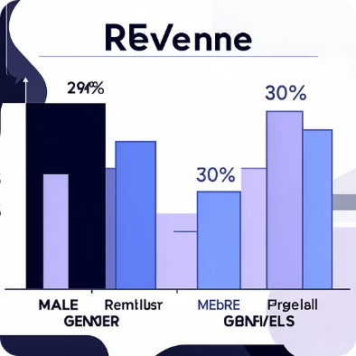
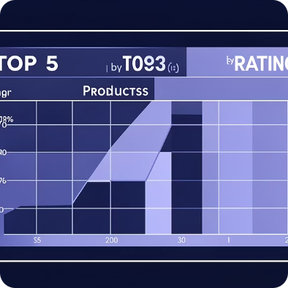
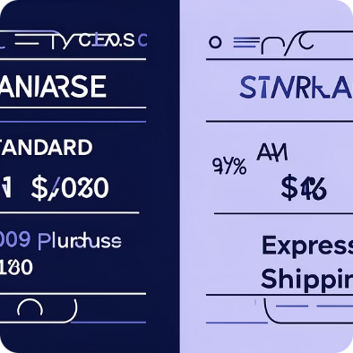
Data Analysis (SQL)
Structured analysis in PostgreSQL answered key business questions.
Revenue by Gender
Top 5 Products by Rating
Shipping Type Comparison
Male: $157,890, Female: $75,191.
Gloves (3.86), Sandals (3.84), Boots (3.82).
Express: $60.48, Standard: $58.46.

Slide 6
SQL Insights: Subscriptions & Discounts
Subscribers vs. Non-Subscribers
Discount-Dependent Products
Yes
1053
$59.49
Hat
50.00%
No
2847
$59.87
Sneakers
49.66%
Coat
49.07%

Slide 7
SQL Insights: Segmentation & Age
1
2
3
Customer Segmentation
Repeat Buyers & Subscriptions
Revenue by Age Group
Loyal (3116), Returning (701), New (83).
Young Adult: $62,143, Middle-aged: $59,197.
958 repeat buyers are subscribers.

Slide 8
Top Products by Category
Accessories
Clothing
Jewelry (171)
Sunglasses (161)
Belt (161)
Blouse (171)
Pants (171)
Shirt (169)
Footwear
Outerwear
Sandals (160)
Shoes (150)
Sneakers (145)
Jacket (163)
Coat (161)

Slide 9
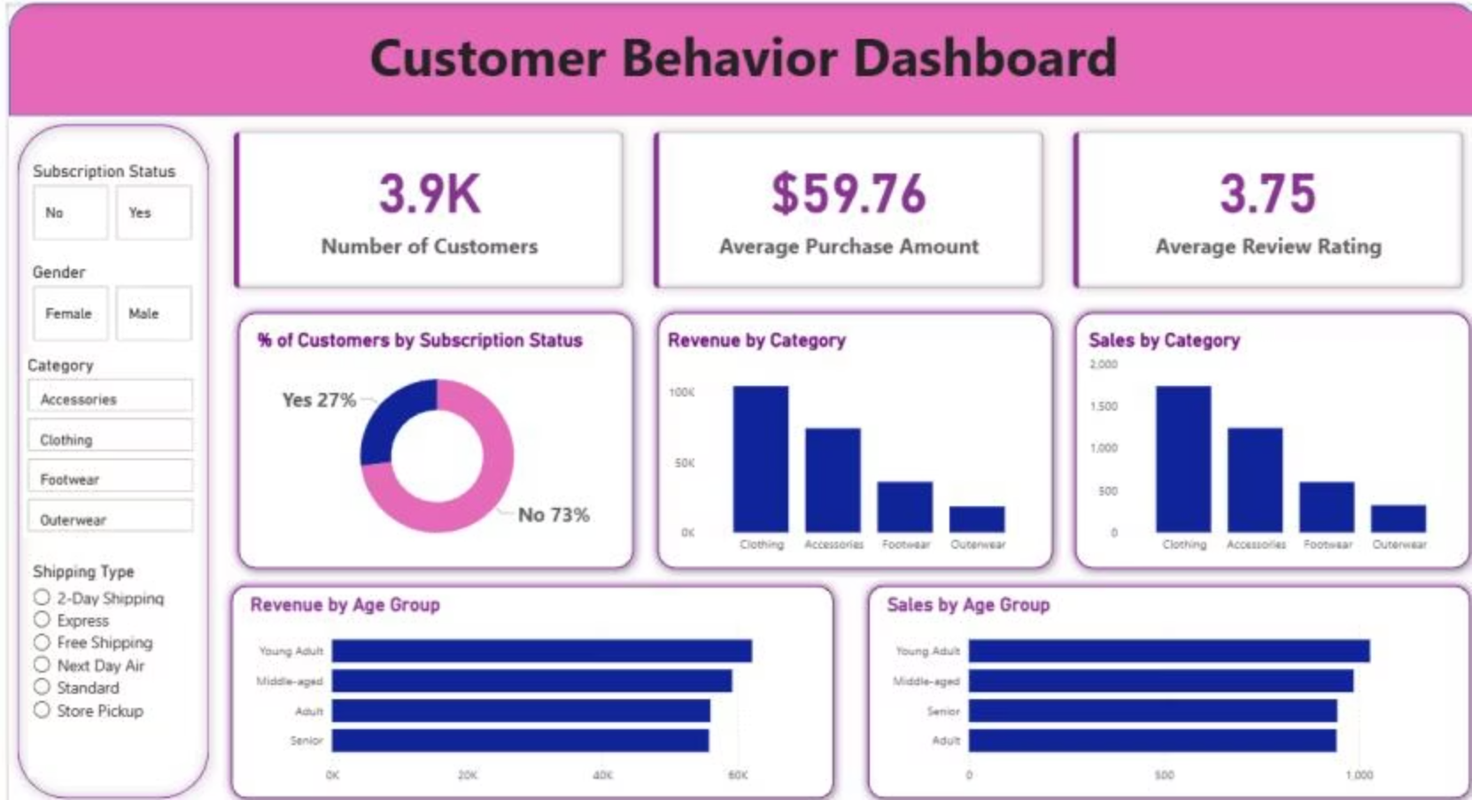



Power BI Dashboard
Interactive visualization of customer behavior insights.
3.9K
$59.76
3.75
Customers
Avg. Purchase
Avg. Rating

Slide 10


Business Recommendations
Boost Subscriptions
Promote exclusive benefits.
Customer Loyalty
Reward repeat buyers.
Review Discount Policy
Balance sales with margin.
Targeted Marketing
Focus on high-revenue groups.

